Slide 1
Gen-AI Powered SQl Genie: Your Intelligent Enterprise Data Discovery Assistant.

Slide 2
MEET OUR TEAM:
K. Shiva Sai Kiran - 4128
M.V. Rahul Vishnu - 4129
M. Fiona Mary - 4130
MENTOR:
ARIVUDAI NAMBI

Slide 3
Contents:
1. Business Objective – Problem ㅤ ㅤStatements.
2. GenAI description.
3. Integrating GenAI into SQL Genie.
4. SQL Genie And Its use cases.
5. Key Challenges.

Slide 4

PROBLEM # 1:
Navigating the Data Puzzle.
OBJECTIVE:
Businesses in data-intensive industries face the challenge of making critical data accessible and understandable to non-technical staff.
By harnessing advanced technologies and GenAI capabilities, we've developed a cutting-edge platform that allows non-technical staff in data-intensive industries to effortlessly access, retrieve, and analyze data using natural language queries.

Slide 5
PROBLEM # 2 :
The Time Constraint Challenge.
OBJECTIVE:
In the competitive landscape of consulting and data analysis, time is of the essence. Our solution is tailored to empower consulting and data analysis firms by significantly increasing their time efficiency and, in turn, driving business success.
We understand that in these industries, time is often spent on repetitive data handling tasks, slowing down project timelines and limiting the capacity for strategic analysis enabling teams to focus on what truly matters - delivering impactful insights and solutions to clients.

Slide 6
How We Plan To Solve These Problems?
SQL Genie is well-designed AI-powered SQL converter which offers a user-friendly interface, making it accessible to individuals without extensive technical expertise.
This can be crucial in industries where personnel may not have a deep understanding of database management.
Automation helps in minimizing human errors that may occur during the manual conversion process. AI algorithms can be trained to accurately understand and convert data from various formats.

Slide 7
GEN AI AND HOW IS IT IMPACTING THE CURRENT WORLD SCENARIO ?
Generative AI (Gen AI) is a type of artificial intelligence that can create new content, such as text, images, and music.
Gen AI can produce highly realistic and complex content that mimics human creativity, making it a valuable tool for many industries such as gaming, entertainment, and product design.
Gen AI systems can create new content in a way that is indistinguishable from human-created content. This has led to several applications in a wide range of industries.

Slide 8
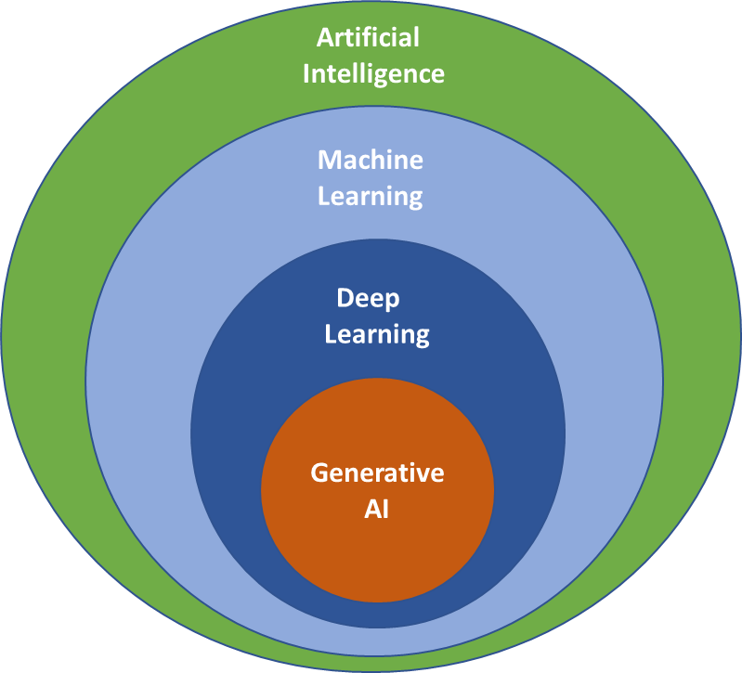
GENAI And Where Does It Fit:

Slide 9
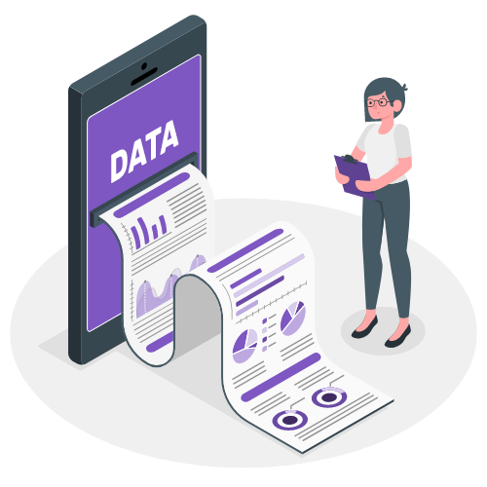
GEN AI AND DATA DISCOVERY :
Gen AI revolutionizes data discovery by translating natural language queries into structured SQL queries.
It bridges the gap between technical and non-technical users, making data exploration more accessible.
Gen AI optimizes queries, adapts to user preferences, and provides insights in everyday language, empowering organizations to make informed decisions and drive success.

Slide 10


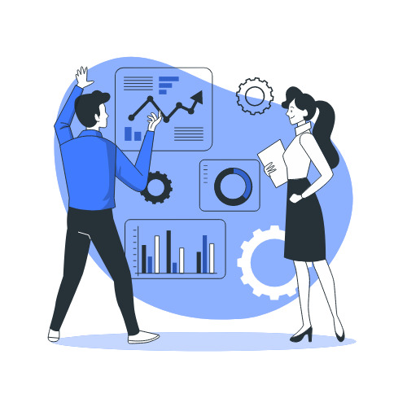
Fields of Exploration: A World of Possibilities.
Assist educators and students
in obtaining educational data,
research materials, and
performance analytics through
conversational queries.
Facilitate medical professionals in accessing patient records, treatment histories, and clinical data through intuitive conversational queries.
Empower retailers to gain real-time inventory insights, monitor sales trends, and optimize supply chain operations with conversational data queries.

Slide 11
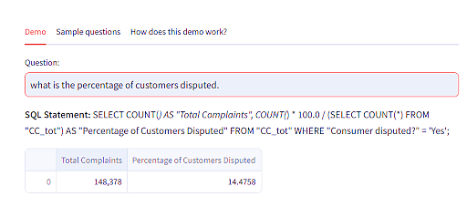
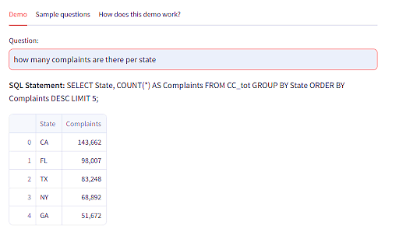
Output Snippets.

Slide 12
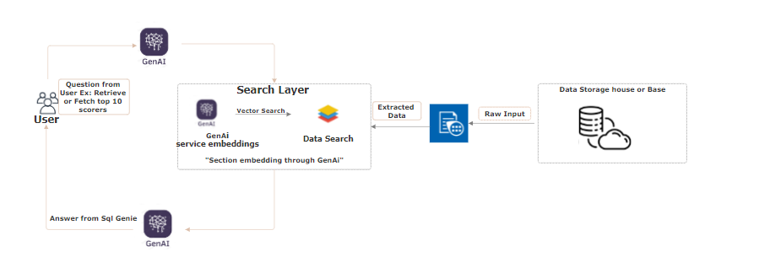
Flow Chart.

Slide 13
Natural Language Processing (NLP)
The field of artificial intelligence (AI) known as "natural language processing" or NLP, aims to provide computers the ability to comprehend, interpret, and produce meaningful and contextually relevant human language.
By examining text and speech data, natural language processing (NLP) seeks to understand the structure, semantics, and intent of human language.
NLP enables the system to interpret questions entered by users and determine their purpose and significance.

Slide 14
Role of Language Models in Our Project:
Large Language Model describes a category of highly developed artificial intelligence models created to comprehend, process, and produce human language while capturing linguistic subtleties, context, and semantics. Language models, like text-davinci-003, are sophisticated AI models trained on vast amounts of text data to understand, generate, and respond to human language in a contextually relevant manner.

Slide 15
Role of Language Models in Our Project:
Large Language Model describes a category of highly developed artificial intelligence models created to comprehend, process, and produce human language while capturing linguistic subtleties, context, and semantics. Language models, like text-davinci-003, are sophisticated AI models trained on vast amounts of text data to understand, generate, and respond to human language in a contextually relevant manner.

Slide 16



LLaMA (Large Language Model Meta AI) is a family of large language models (LLMs), released by Meta AI starting in February 2023.
For the first version of LLaMA, four model sizes were trained: 7, 13, 33 and 65 billion parameters.
The Pathways Language Model is the name of a family of AI large language models developed by Google.
PaLM is a 540 billion parameter transformer-based large language model.
Developed by OpenAI, ChatGPT is one of the most recognizable large language models.
It utilizes massive datasets, often featuring 100 million or more parameters, in order to solve common language problems

Slide 17
GPT-3 (Generative Pre-trained Transformer 3) – This is one of the largest Large Language Models developed by OpenAI. It has 175 billion parameters and can perform many tasks, including text generation, translation, and summarization.
BERT (Bidirectional Encoder Representations from Transformers) – Developed by Google, BERT is another popular LLM that has been trained on a massive corpus of text data. It can understand the context of a sentence and generate meaningful responses to questions.
XLNet – This LLM developed by Carnegie Mellon University and Google uses a novel approach to language modeling called “permutation language modeling.” It has achieved state-of-the-art performance on language tasks, including language generation and question answering.
T5 (Text-to-Text Transfer Transformer) – T5, developed by Google, is trained on a variety of language tasks and can perform text-to-text transformations, like translating text to another language, creating a summary, and question answering.
RoBERTa (Robustly Optimized BERT Pretraining Approach) – Developed by Facebook AI Research, RoBERTa is an improved BERT version that performs better on several language tasks.

Slide 18
KEY CHALLENGES:
Natural Language Understanding (NLU): Ensuring the system accurately understands and interprets the wide range of natural language queries from users.
Data Complexity: Dealing with complex and unstructured data sources, which may require substantial preprocessing.
Real-time Data Streams: Integrating with real-time data streams and maintaining up-to-the-minute data accuracy.
Cost and Resource Optimization: Optimizing cloud resource usage and AI model efficiency to minimize costs.
Data Display: The Structure of data is unordered
And it could be solved by Pandas conversion.
Outlier Correction: Correcting the queries that are wrong using Agents.

Slide 19
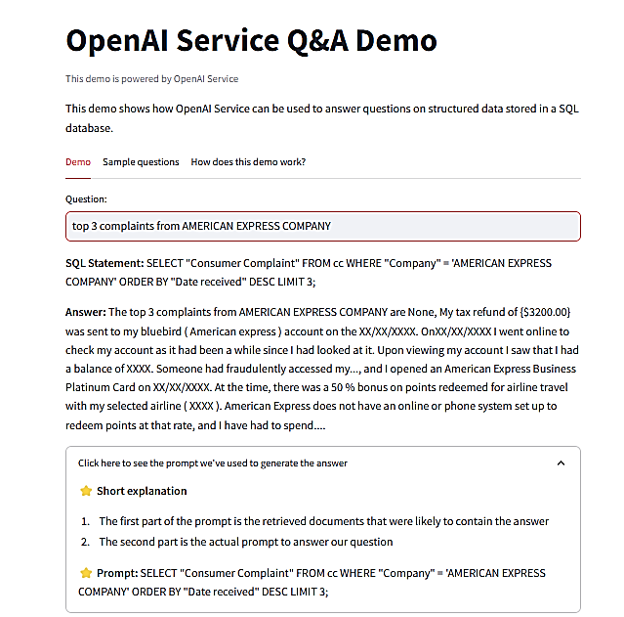
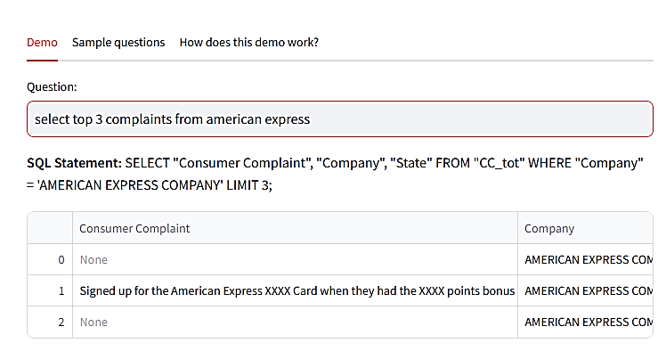
DataFrame Conversion

Slide 20
Let's collaborate and embark this journey together.

